Slide 1


Hadoop File Formats
Part 2
Notes:
Part 2

Slide 2
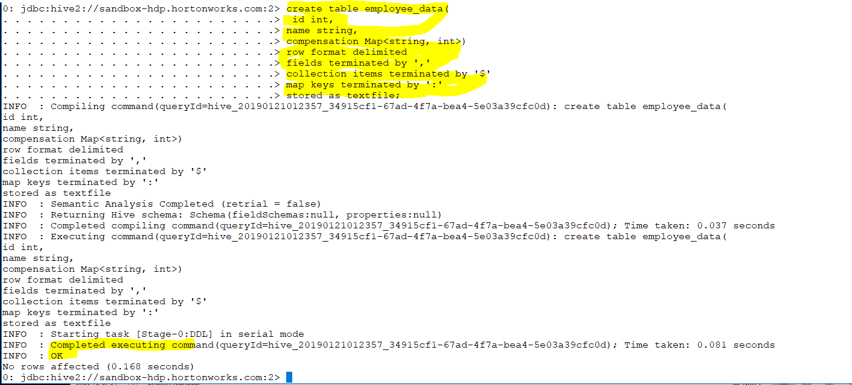
Collections
Means collection of data for certain column . It could be list (list of value)..
Notes:
Collections
========:
Means collection of data for certain column .It could be list (list of value).Single column make single value
We need collection of data type .
It could be map of value

Slide 3
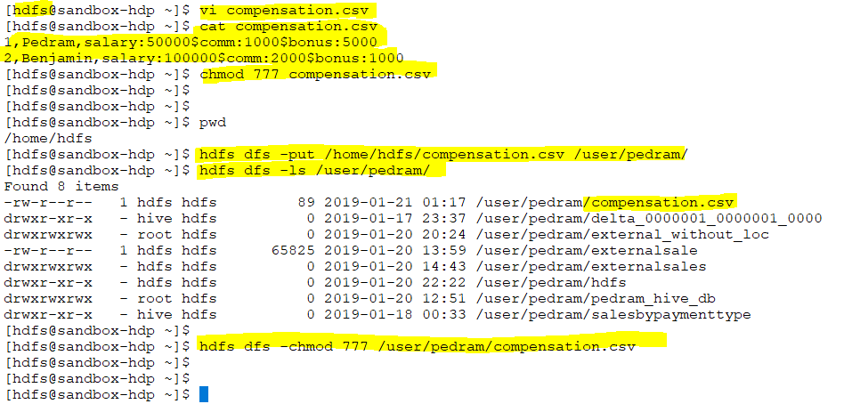

Slide 4
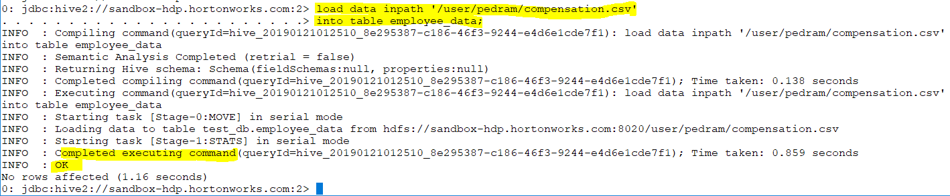

Slide 5
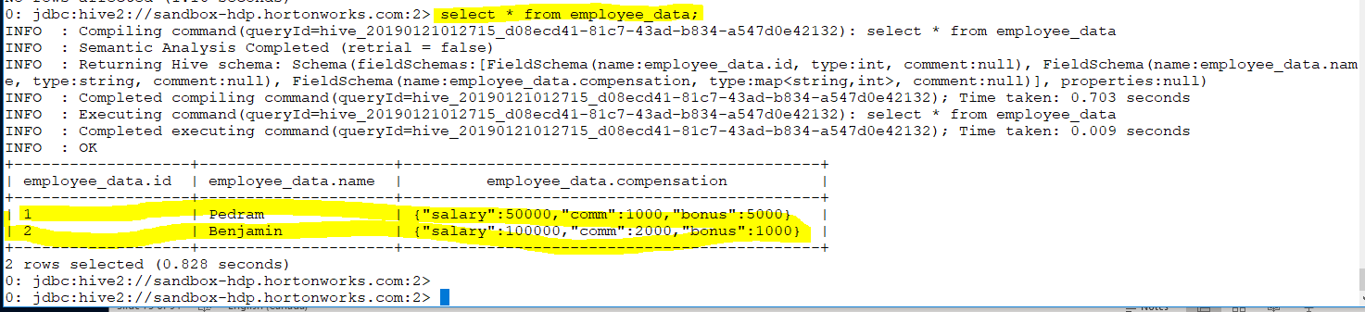
Notes:
1,Pedram,salary:50000$comm:1000$bonus:5000
2,Benjamin,salary:100000$comm:2000$bonus:1000

Slide 6
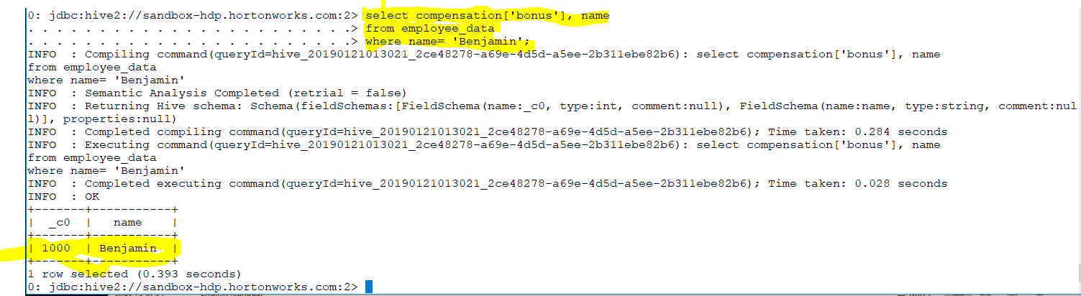

Slide 7
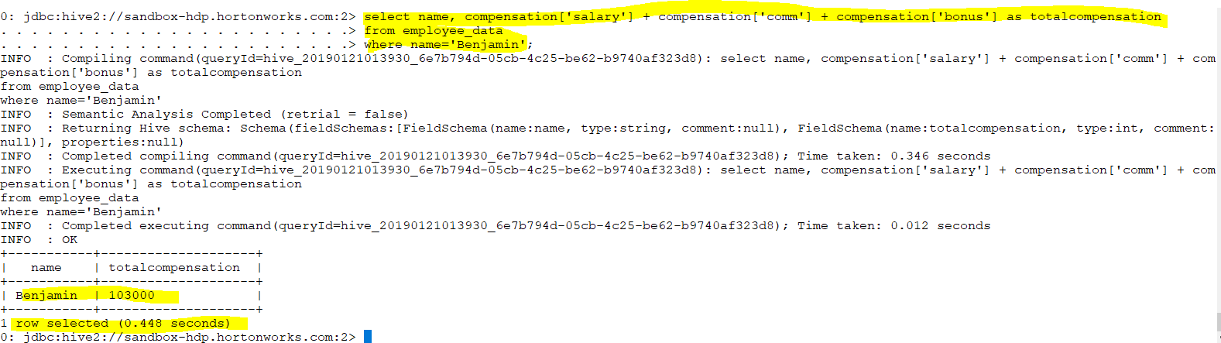
We can use mathematics operation
Notes:
You can see we got more complexity

Slide 8
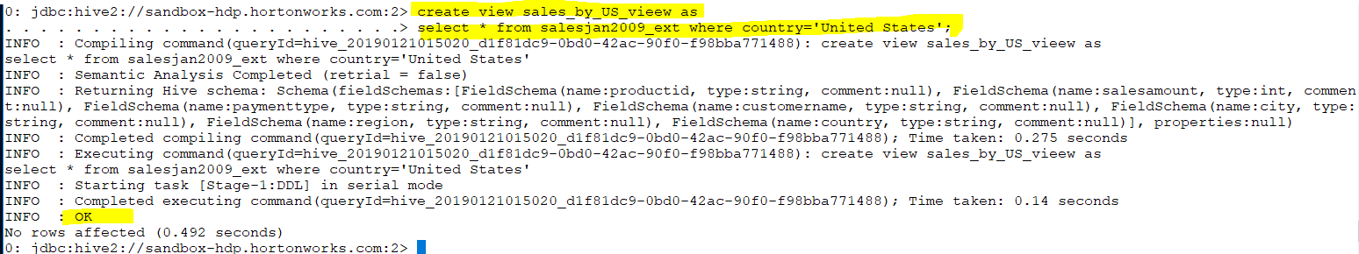
View
It is a snapshot of one or more table so any time we need we can refer to it.
Notes:
View
=======
Is a snapshot of one or more table so any time we need we can refer to it.
View is intermediate datatype structure

Slide 9
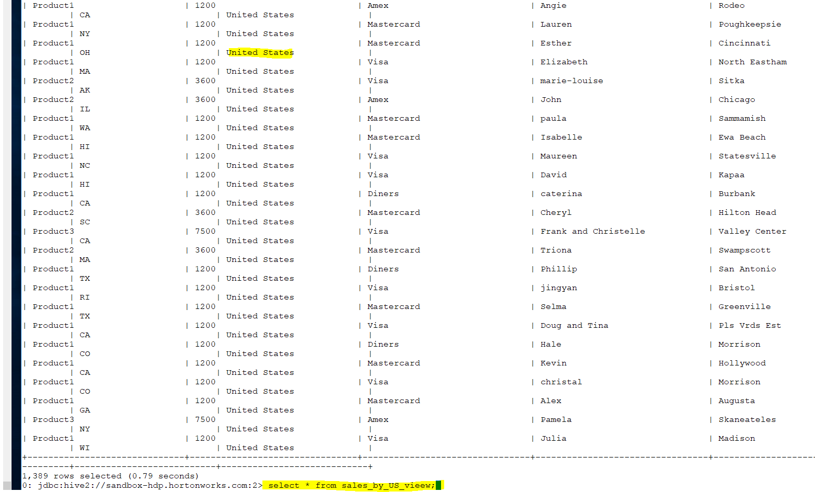

Slide 10
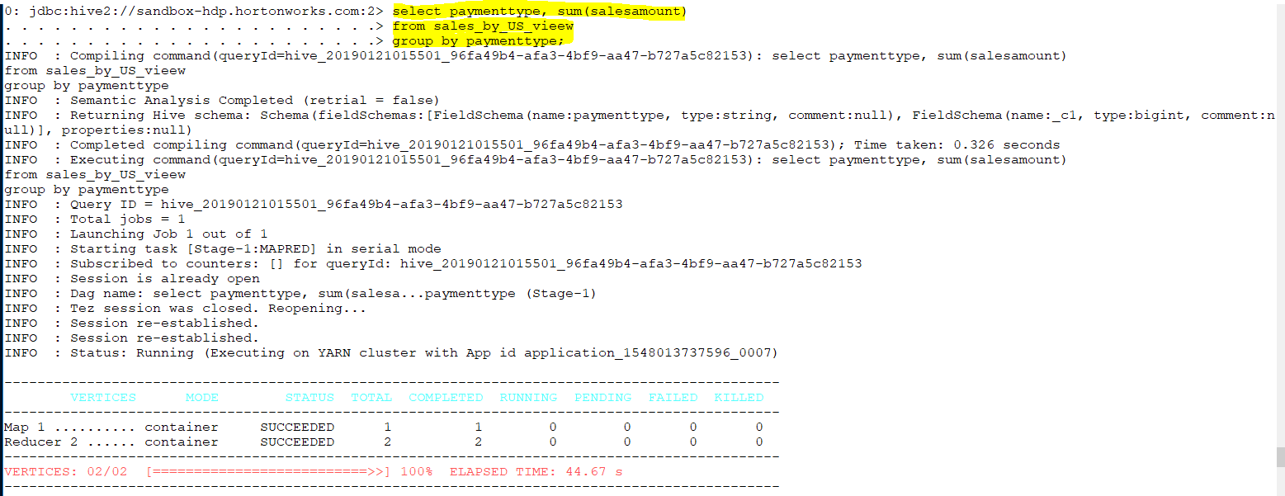
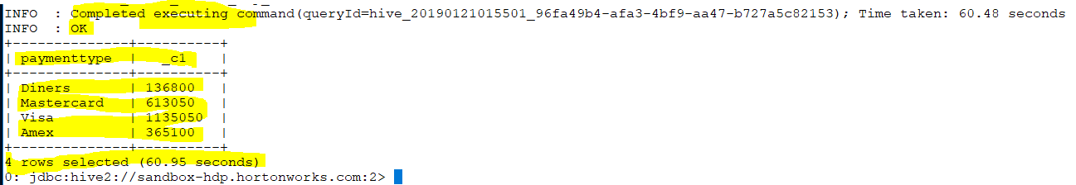
Notes:
As you can see any time I need I use view like example above

Slide 11
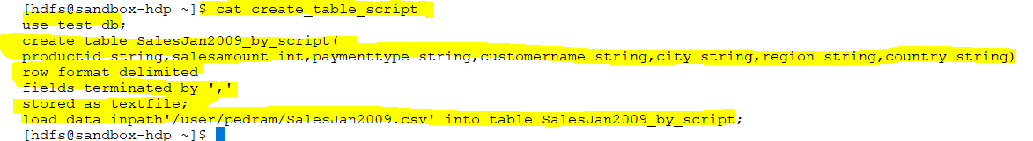
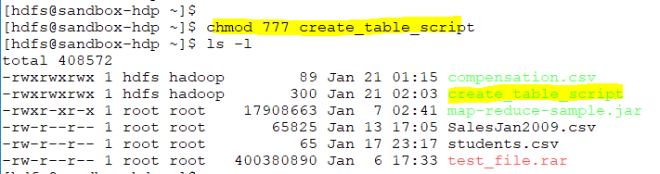
Script
Notes:
Script
======

Slide 12
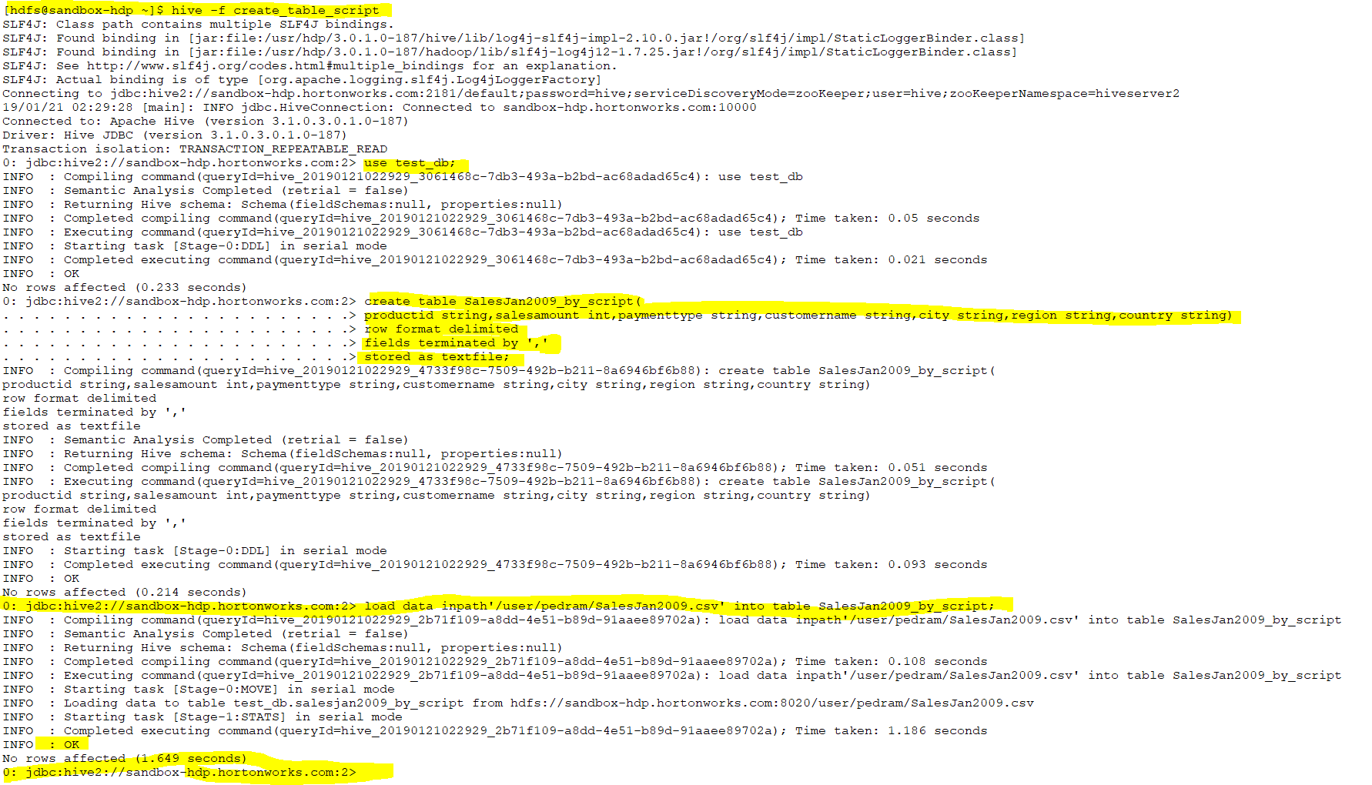

Slide 13
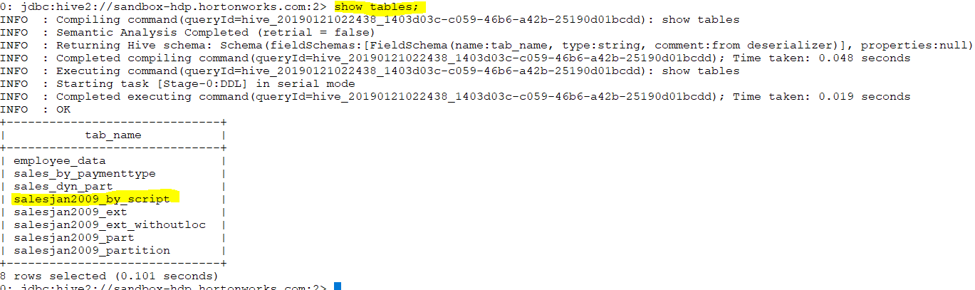

Slide 14
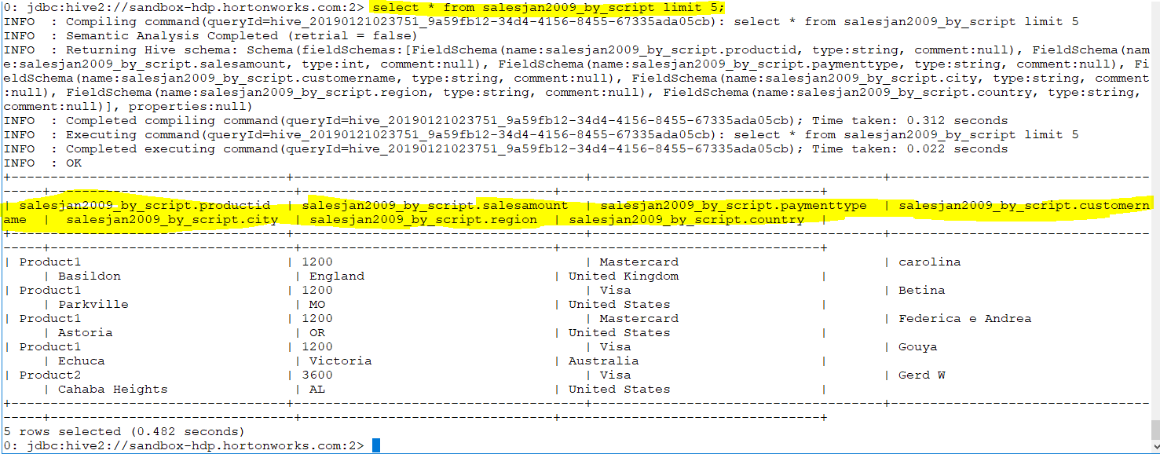

Slide 15
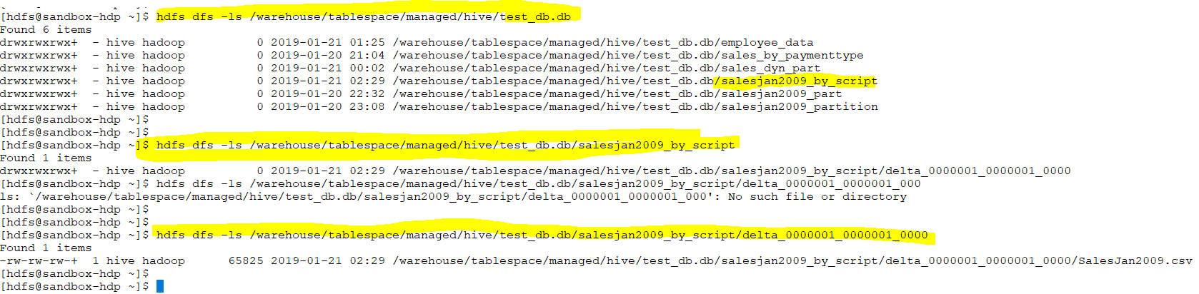

Slide 16
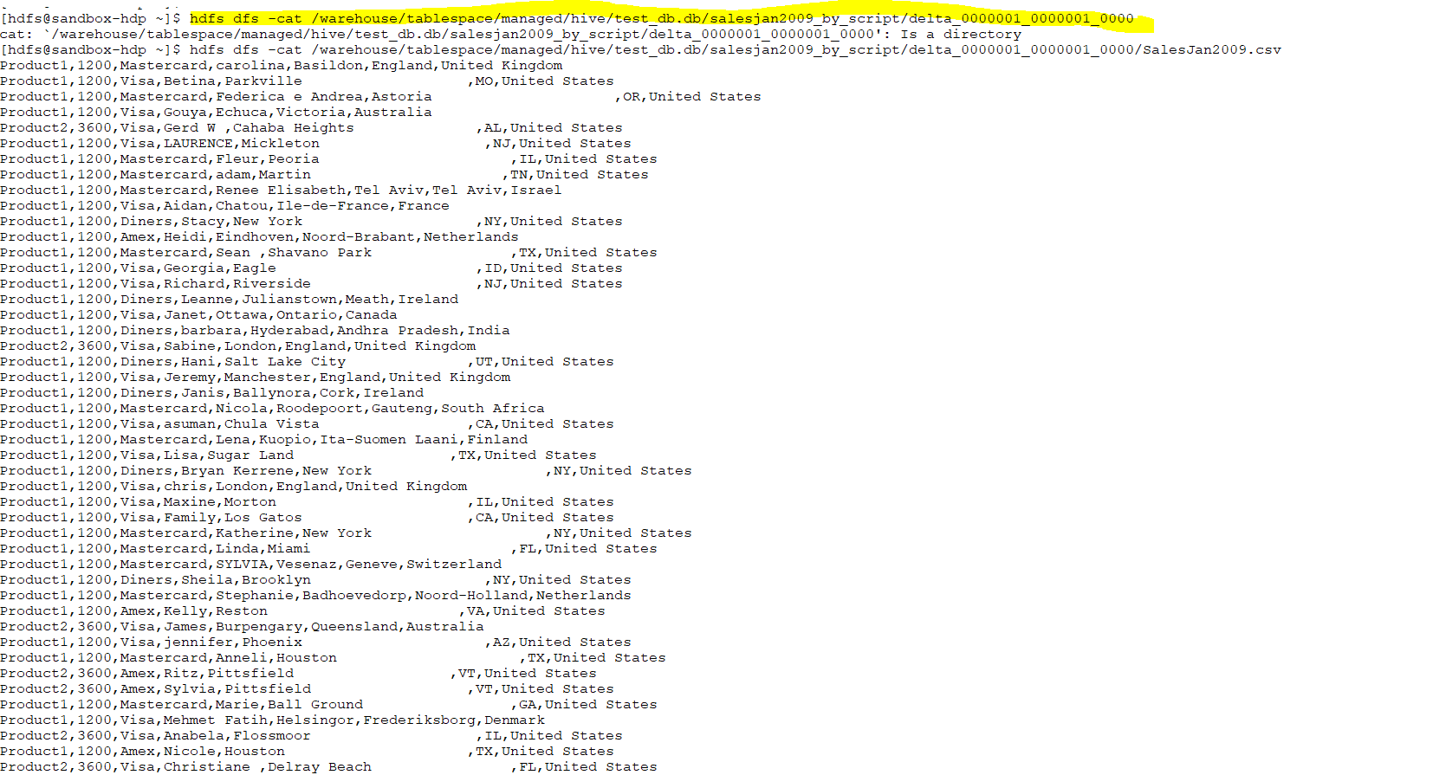

Slide 17

Advance Hive

Slide 18
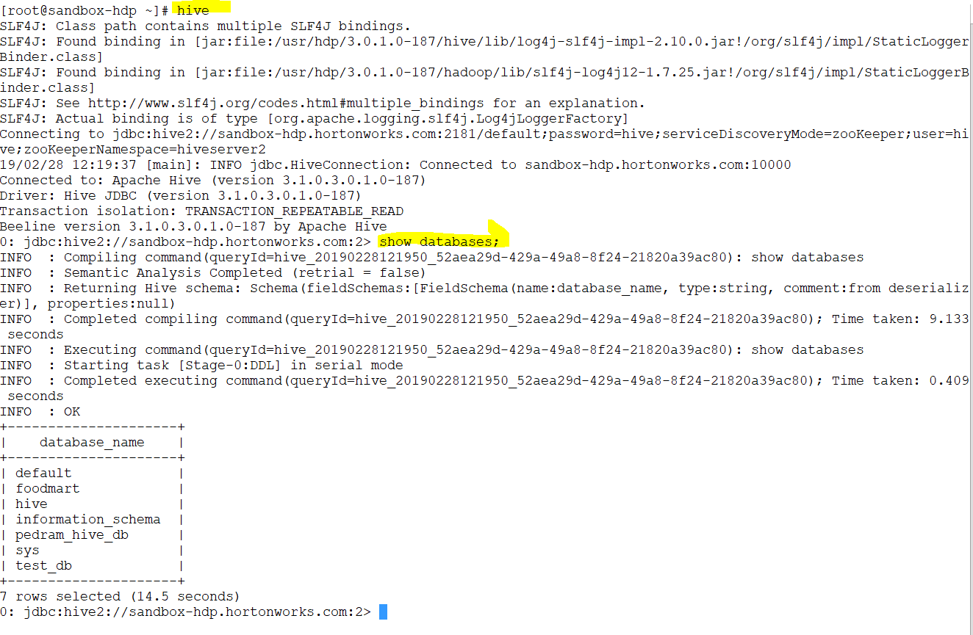

Slide 19
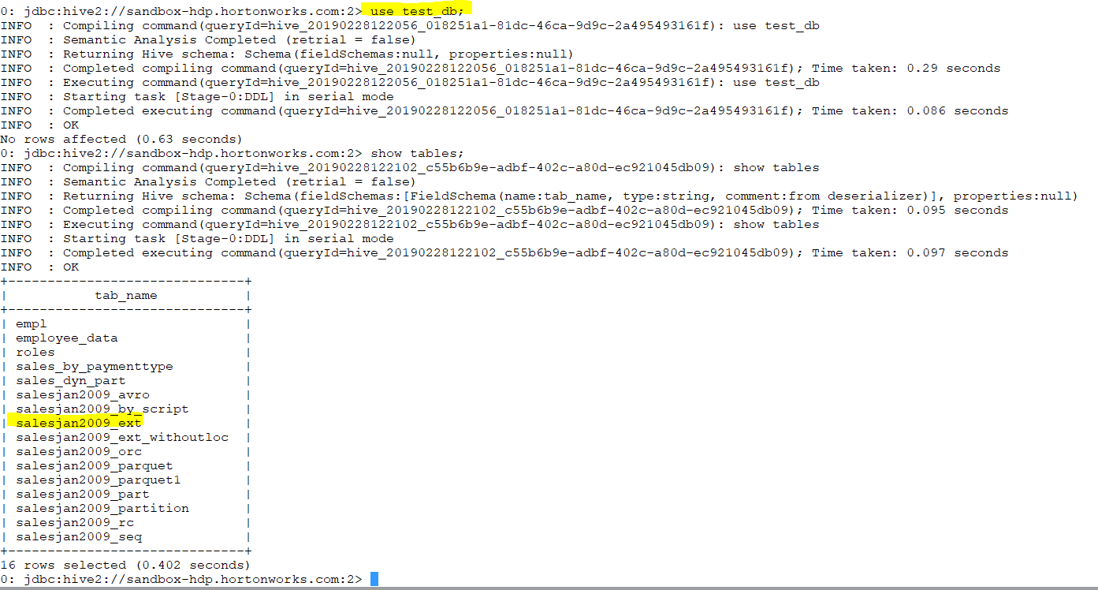

Slide 20
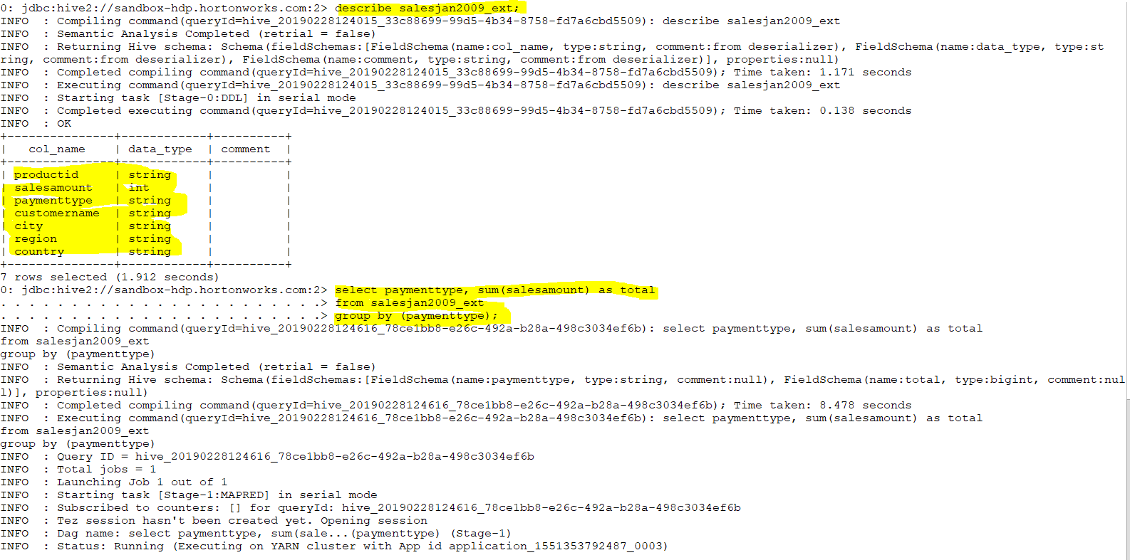
Objective :I wish Get the total amount of sales per payment type and store it in the table
Notes:
I wish Get the total amount of sales per payment type and store it in the table
select paymenttype, sum(salesamount) as total
from salesjan2009_ext
group by (paymenttype);

Slide 21
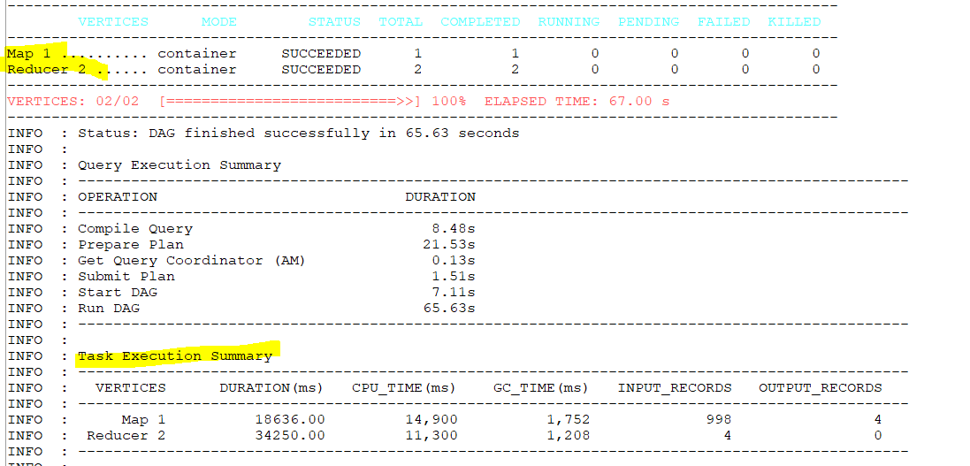
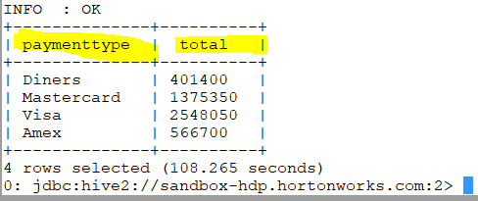

Slide 22
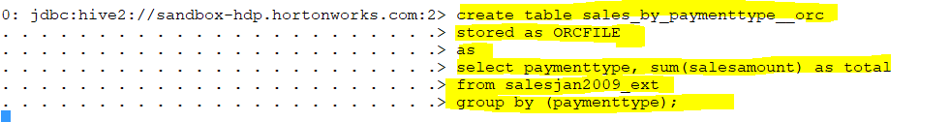
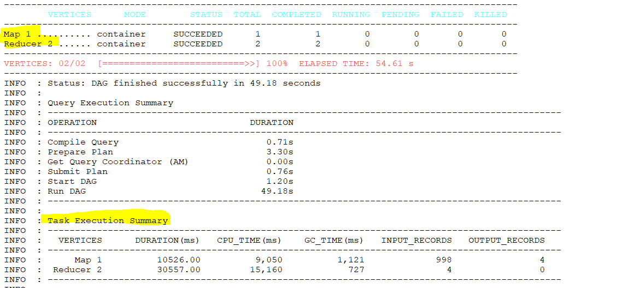
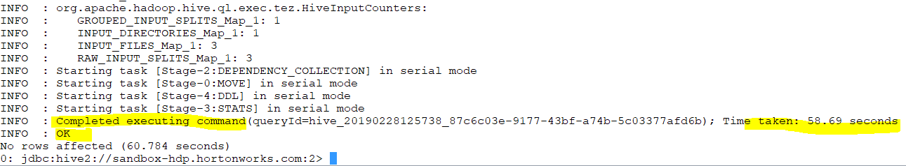
Notes:
create table sales_by_paymenttype__orc
stored as ORCFILE
as
select paymenttype, sum(salesamount) as total
from salesjan2009_ext
group by (paymenttype);
It takes the data and query from table

Slide 23
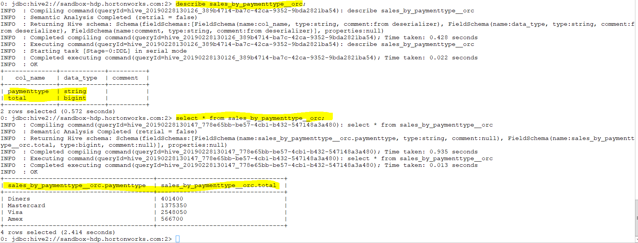

Slide 24
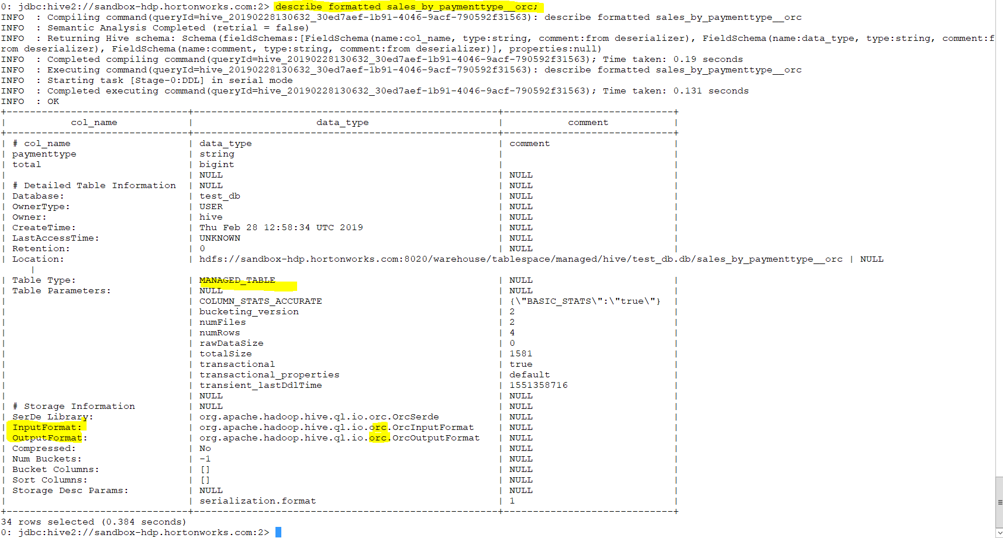

Slide 25
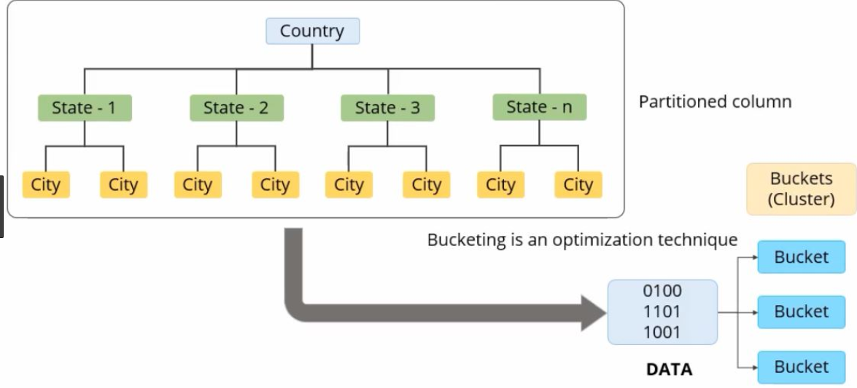
Bucketing
based on Hash of particular columns
Notes:
Buckets in hive is used in segregating of hive table-data into multiple files or directories. it is used for efficient querying.
The data i.e. present in that partitions can be divided further into Buckets
The division is performed based on Hash of particular columns that we selected in the table.
Buckets use some form of Hashing algorithm at back end to read each record and place it into buckets
In Hive, we have to enable buckets by using the set.hive.enforce.bucketing=true;
========================================================================================================
Bucketing : We use Hive for analyzing .if our data set is big the query will take time so if I do the query in subset of data that will be faster .
To use sampling in proper way or facilities sampling hive provides bucketing. For bucketing we need to choose a column which we are going to do bucketing

Slide 26
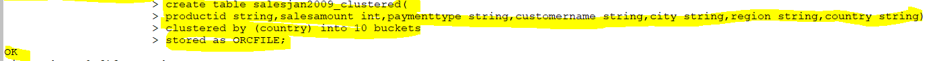
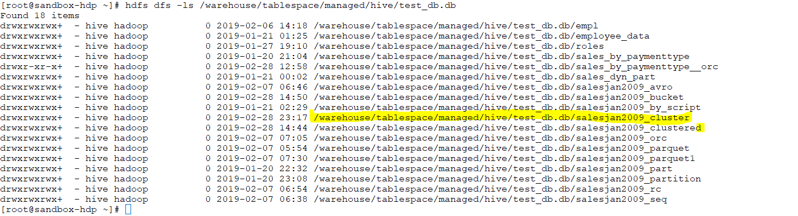
Bucketing
Bucketing : We use Hive for analyzing .if our data set is big the query will take time so if I do the query in subset of data that will be faster .
Notes:
=======================================================================================================
0: jdbc:hive2://sandbox-hdp.hortonworks.com:2> create table salesjan2009_clustered(
productid string,salesamount int,paymenttype string,customername string,city string,region string,country string)
clustered by (country) into 10 buckets
stored as ORCFILE;
==========================

Slide 27
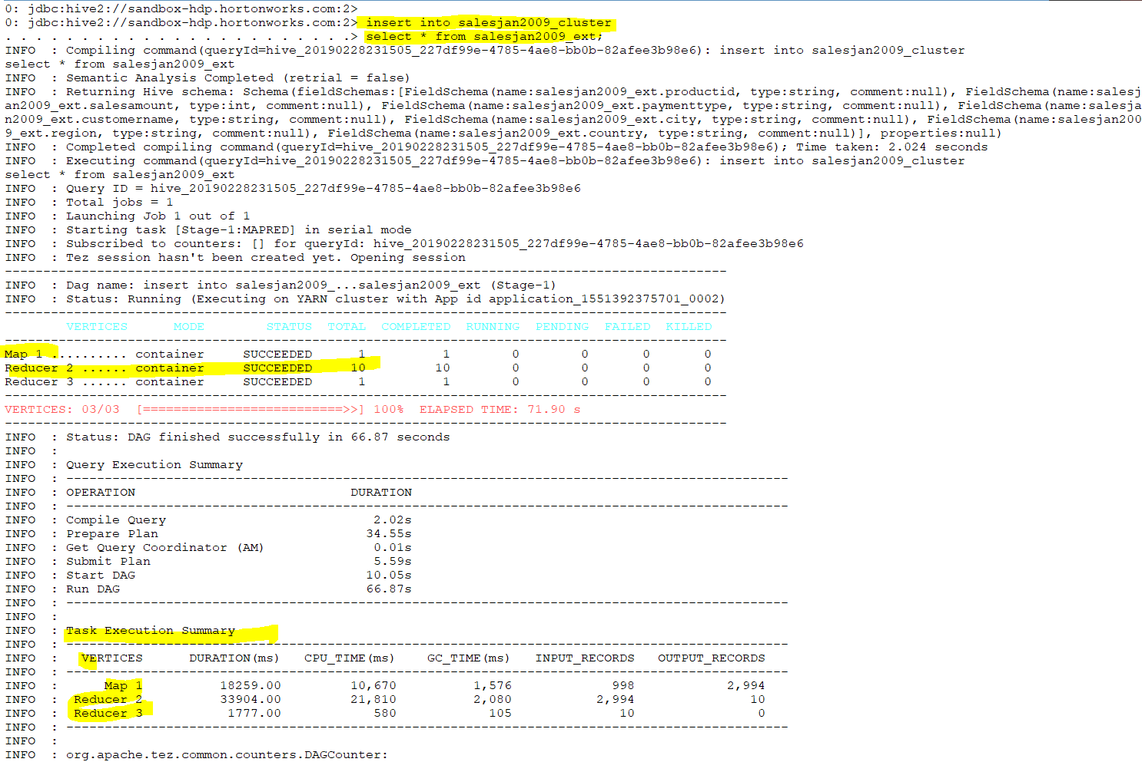
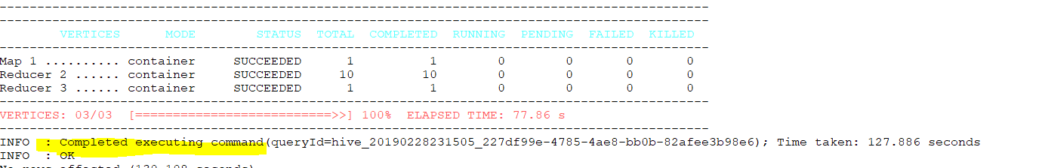

Slide 28
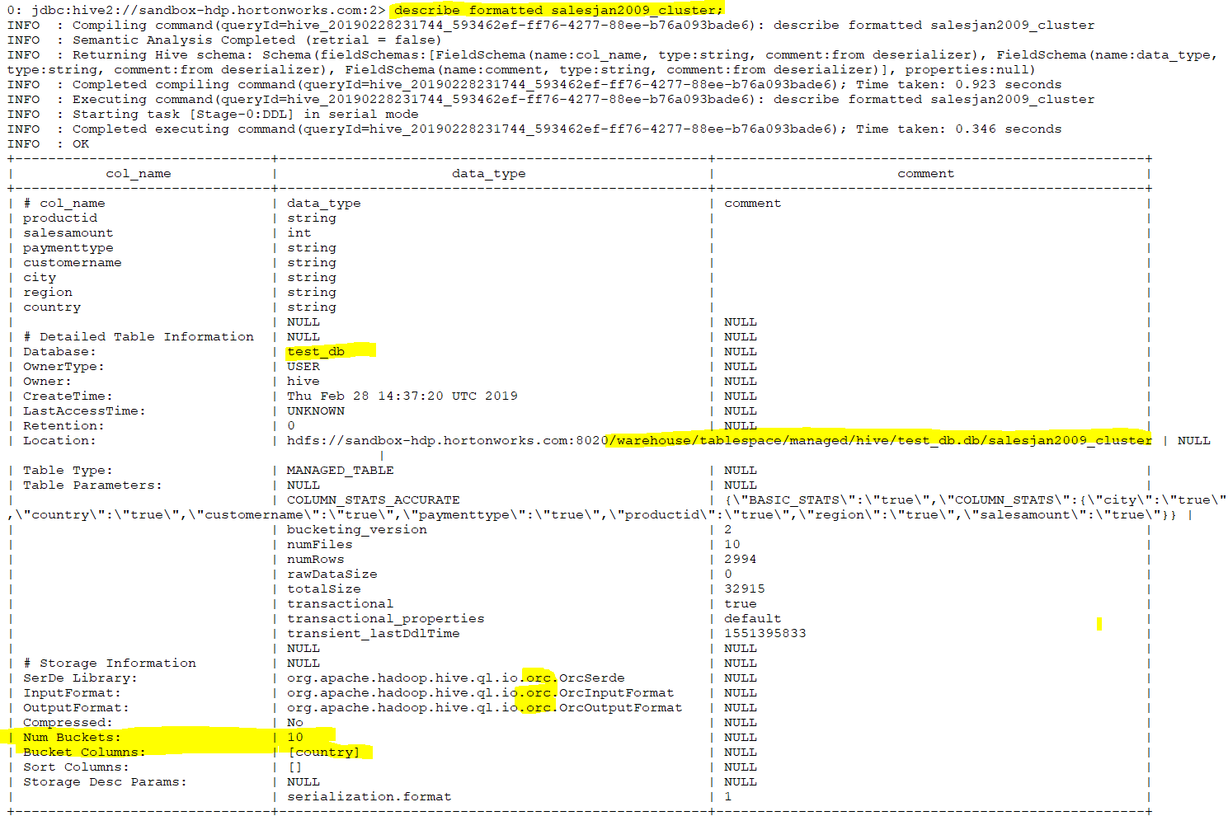

Slide 29
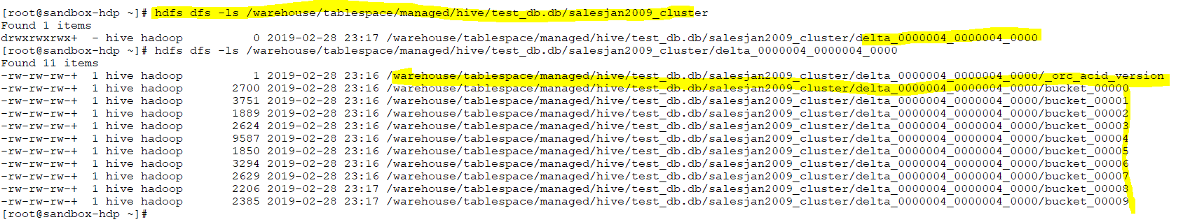
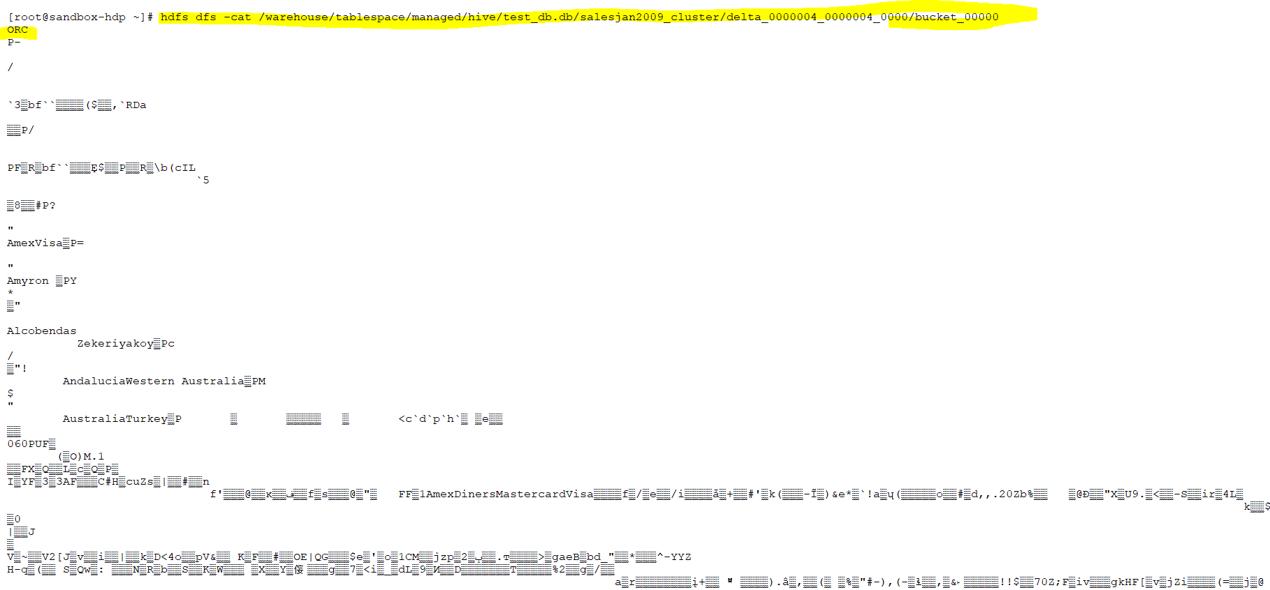

Slide 30
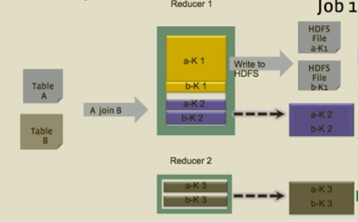
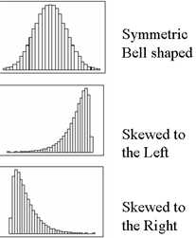
Skewed

Slide 31
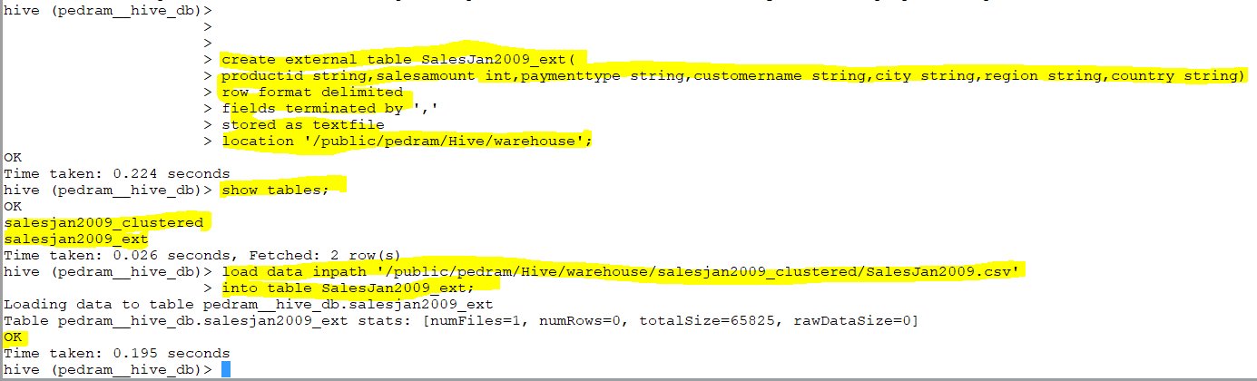
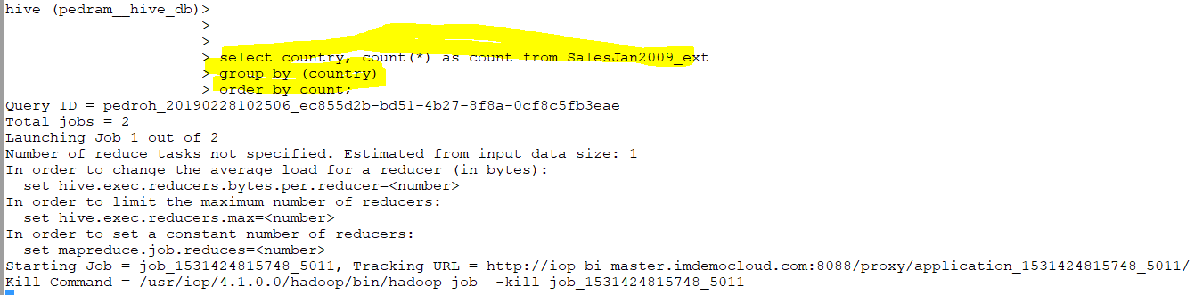
Notes:
What is a skewed table in Hive? -. A skewed table is a special type of table where the values that appear very often (heavy skew) are split out into separate files and rest of the values go to some other file.. create table <T> (schema) skewed by (keys) on ('c1', 'c2') [STORED as DIRECTORIES];

Slide 32
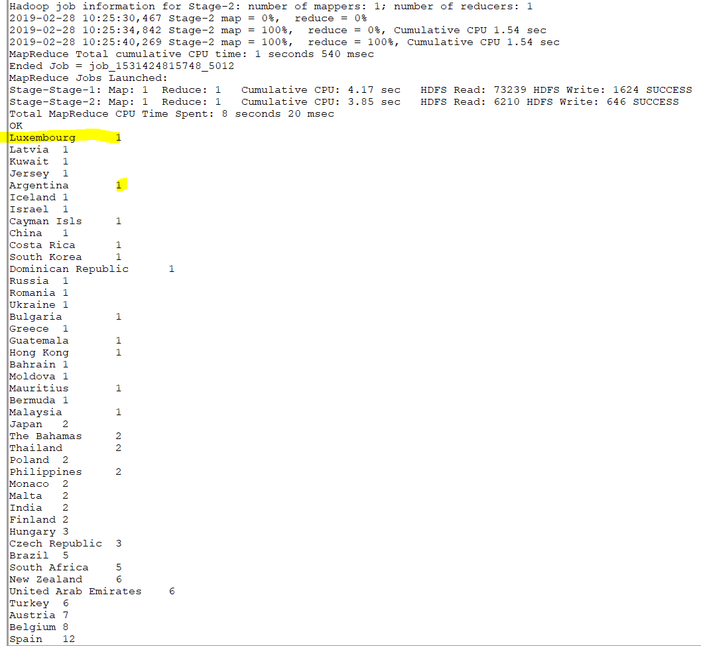
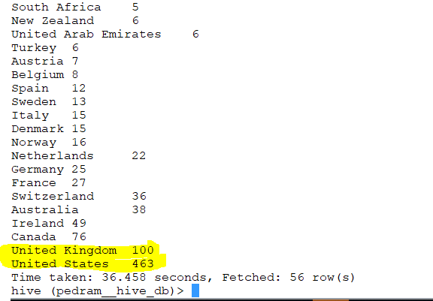
Notes:
Most of the country have one record however us and uk have the highest number of records.
Before we saw : we partitioned data by payment type then country
Imaging we partition by country .why we do partitioning ? We partition it when we want to achieve faster query .
If my where clause has condition where country is us and I have partition the data based on payment type my query will not give me any benefits
But if my data is partitioned based on country and my where clause also has condition based on country then you will see the benefit.
My where clause may use the column which is the column which is partitioned. would it give me benefit if I partition based on country ? No
Because only us and uk has large number in another word the total number of data from other country are less than uk and us
This is called skewed data

Slide 33
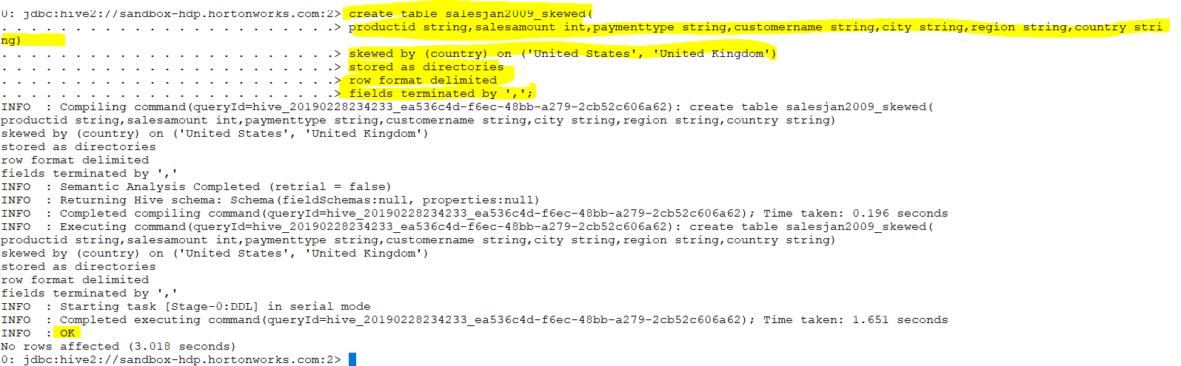
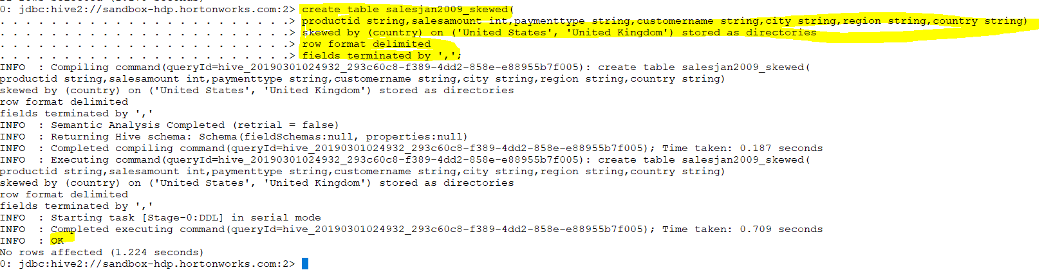
Notes:
create table salesjan2009_skewed(
> productid string,salesamount int,paymenttype string,customername string,city string,region string,country string)
> skewed by (country) on ('United States', 'United Kingdom') stored as directories
> row format delimited
> fields terminated by ',';

Slide 34
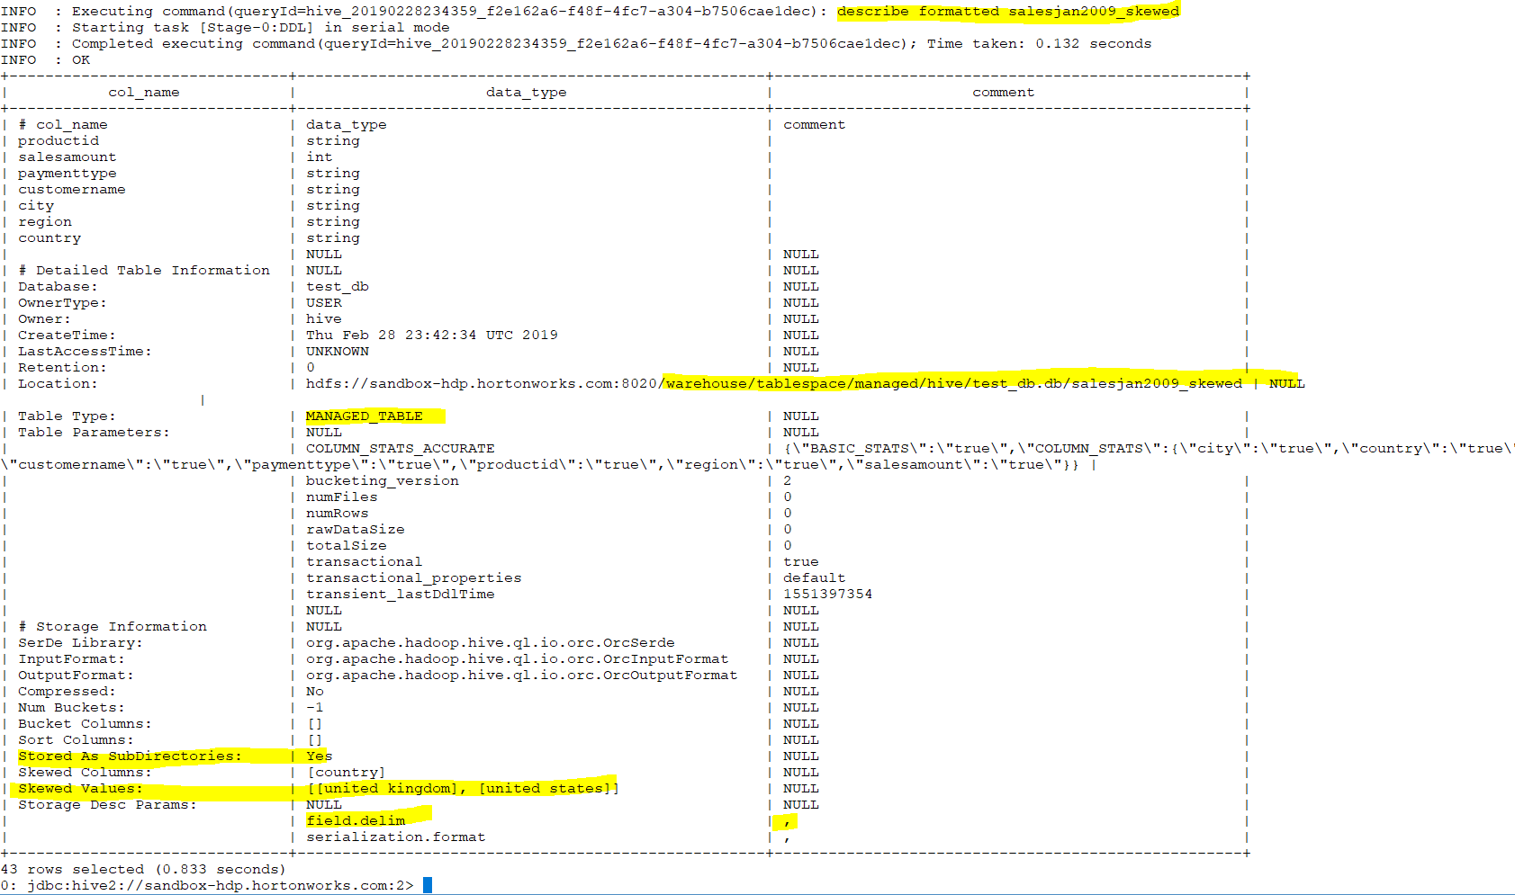

Slide 35
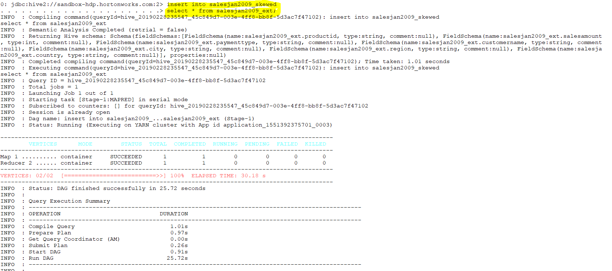

Slide 36
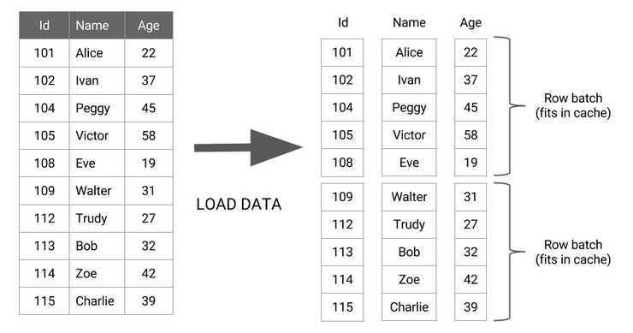
Vectorization: Process batch of records instead of row
Notes:
By default, the Hive query execution engine processes one row of a table at a time. The single row of data goes through all the operators in the query before the next row is processed, resulting in very inefficient CPU usage. In vectorized query execution, data rows are batched together and represented as a set of column vectors. The basic idea of vectorized query execution is to process a batch of rows as an array of column vectors:

Slide 37
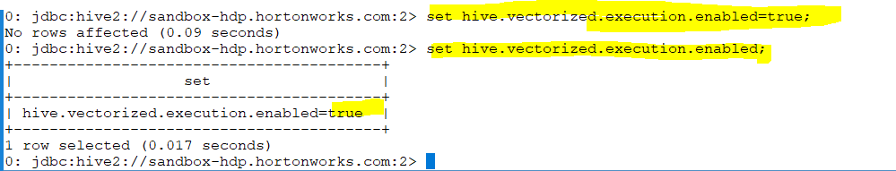
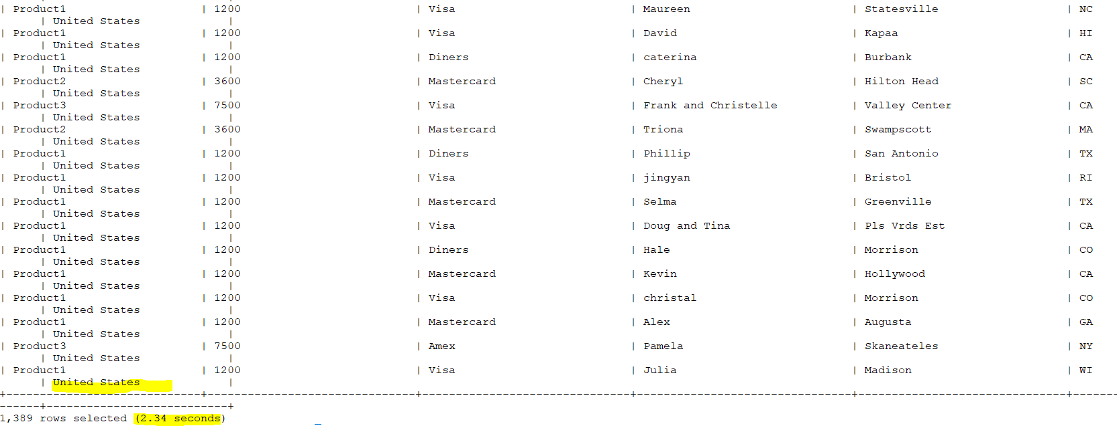
Notes:
what is it vectorization ? when I specify a key ,Hive combines all the records into multiple groups or bucket based on the key based on filter condition which is country here .
Hive will grouped the certain records to 10 groups for example. then apply the condition to those groups which will be faster . (1000 records will be inserted to 10 groups then condition will be applied to each group .
whenever you have select or filter enable vectorization

Slide 38
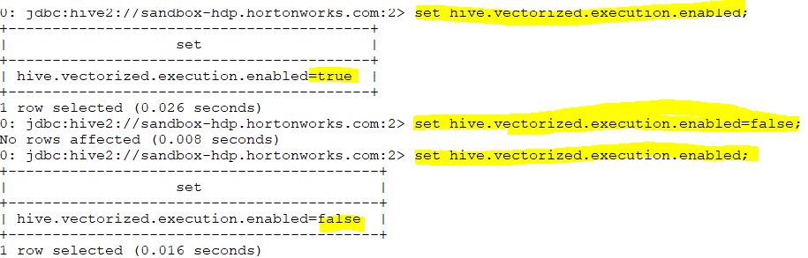
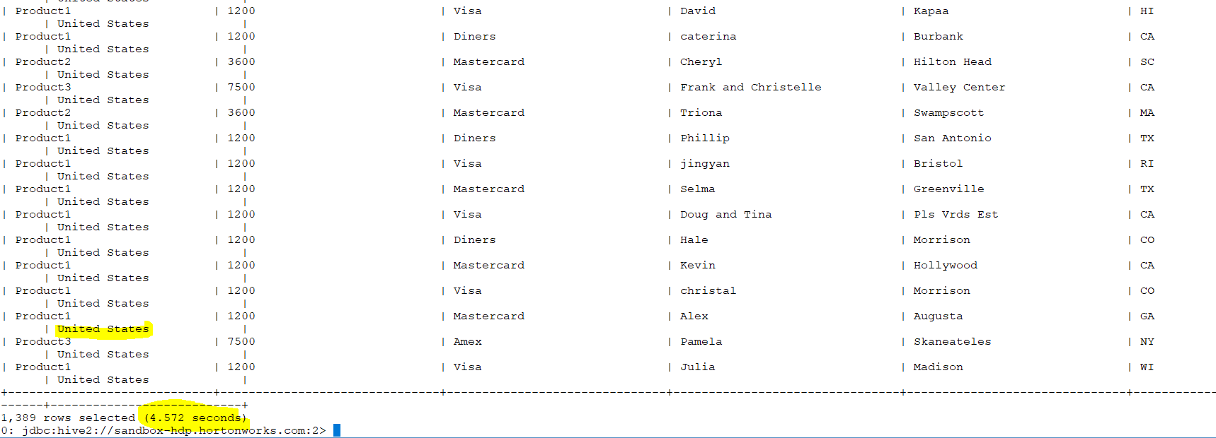
Notes:
what is it vectorization ? when I specify a key ,Hive combines all the records into multiple groups or bucket based on the key based on filter condition which is country here .
Hive will grouped the certain records to 10 groups for example. then apply the condition to those groups which will be faster . (1000 records will be inserted to 10 groups then condition will be applied to each group .
whenever you have select or filter enable vectorization
Process batch of records instead of row
Lesser cpu cycles

Slide 39


Slide 40

Inner Join:

Slide 41


Slide 42


Slide 43


Slide 44



Slide 45


Slide 46
Full Outer Join
Notes:
select p.name, s.salesamount, s.paymenttype, s.country
from product p full outer join salesjan2009_ext s
on (p.id = s.productid);

Slide 47



Slide 48
Left Outer Join:
Notes:
Left Outer Join:
select p.name, s.salesamount, s.paymenttype, s.country
from product p left outer join salesjan2009_ext s
on (p.id = s.productid);

Slide 49


Slide 50
Right Outer Join:

Slide 51


Slide 52


Delete and update
Notes:
Delete and update

Slide 53



Slide 54




Slide 55
Hadoop File Formats

Slide 56
Formats Available
Plain Text
Sequence Files
Avro
Parquet
RC
ORC
Notes:
Hadoop has its own file system like hdfs .There are many others .
As It has its own file system so it is free to use it.
Hadoop deals with big data .Imaging you have brought the data and put it in the HDFS. your data contains two million records and each records has 1000 columns .
You try to analysis the data .which tool do you use ? When you use hive you might choose which column you use .
Do you think if we store it as text file ,will be beneficial for us ?No
If I split it to horizontally PARTITION it (blocks) (for example 100,000 in a block. the second 100000 in the second block) .If we go to each block there are only few columns .(Only contain number of columns are there)
Parquet , RC, ORC are Column format (
1 file may not contains all the columns of the record but it always contains all the values for certain column.

Slide 57
Benefits
Faster read times
Faster write times
Splittable files
Schema support
Compression support

Slide 58

Notes:
Do you see any product name ? No .Hadoop will associate the product name to the column.so you see how important is schema support.

Slide 59
Text Format
Mostly structured data
Splittable
Compression is done at the file level
Notes:
When I receive a text file it is not mandatory that it is structure format.

Slide 60
Sequence Files
Records are stored in binary format
Saves space compared to text files
Binary conversion is achieved through custom serialization/deserialization
Stored as key-value pairs
Supports block level compression
Splittable at the block level

Slide 61


Slide 62

Notes:
create table salesjan2009_seq(
productid string,
salesamount int,
paymenttype string,
customername string,
city string,
region string,
country string)
stored as SEQUENCEFILE;

Slide 63

Notes:
Hadoop stores data in HDFS to process the data .Hadoop first write the data and read the data to process the data so Map reduce come to play .
You read the file using reader before mapper. after reducer there was record writer .We need record reader and writer because we have different file format .
For every file format there is an record reader type and record writer type.
Record reader helps to read the files and record writer helps to write the files
So by default the record reader is text file and the record writer is text writer .
This reader use input format
When the sequence file reader reads the data it uses sequence file output format
When the sequence file writer writes the data it use sequence file output format
Reader + map + reducer + writer

Slide 64
Notes:
Text format vs sequence format

Slide 65


Slide 66



Slide 67


Notes:
Key comes before the record
/warehouse/tablespace/managed/hive/test_db.db

Slide 68

Notes:
As you can see the file is text but the storage is binary format.

Slide 69
Avro Files
Primarily used when the records can be converted back and forth between Java objects and data
Provides out-of-the-box object level serialization/deserialization
Notes:
Goods for object oriented files
We can covet our csv such a way each record covert to java object .Each record has 7 attribute (product id ,sales amount ,…)
object level means record level

Slide 70

Notes:
create table salesjan2009_avro(
productid string,
salesamount int,
paymenttype string,
customername string,
city string,
region string,
country string)
stored as AVROFILE;

Slide 71


Slide 73

Notes:
Use case of this will be MapReduce which use object oriented program

Slide 74


Slide 75
Columnar File Formats
Includes Parquet, RC & ORC
Stores values as columns instead as rows
Essentially, datasets are partitioned in a columnar fashion
Data in the same column is compressed together that results in huge storage optimizations

Slide 76

Notes:
create table salesjan2009_parquet(
productid string,
salesamount int,
paymenttype string,
customername string,
city string,
region string,
country string)
row format delimited
fields terminated by ','
stored as PARQUETFILE;

Slide 77


Slide 78


Slide 79


Notes:
Stored countries (coulmns)

Slide 80

RC (Optimized Row )
Notes:
create table salesjan2009_rc(
productid string,salesamount int,paymenttype string,customername string,city string,region string,country string)
stored as RCFILE;

Slide 81


Slide 82


Slide 83

Notes:
All country

Slide 84

ORC or Optimized Row Columnar
Notes:
orc

Slide 85

Notes:
All country

Slide 86

Notes:
All country

Slide 87

Notes:
Its binary and optimized format
Among them parquet give the balanced one

Slide 88
Compression in Hadoop
File level compression
BZip2
LZO
Block level compression
Snappy

Slide 89


Notes:
create table salesjan2009_parquet1(
productid string,salesamount int,paymenttype string,customername string,city string,region string,country string)
stored as PARQUET
TBLPROPERTIES ("parquet.compress"="snappy");

Slide 90



